Slide 1
HADARIN MU’AMALA A SHAFUKAN SADA ZUMUNTA
Abdullahi Salihu Abubakar (Baban Sadik)
BS Digital Solutions, Abuja
www.facebook.com/babansadik <=> www.twitter.com/babansadik
fasaha2013@gmail.com
08034592444

Slide 2
MAKUNSHI
Gabatarwa
Ma’anar “Social Media”
Nau’uka – Wayar Salula ko Kwamfuta ko Duka
Bayani kan tushe da asali
Samuwar Fasahar Intanet
Samuwar Salula
Tsarin Mu’amala a Dandalin Sada Zumunta
Wasu Alkaluma
Asali da Samuwar Fasahar Intanet
Asali da Samuwar Wayar Salula a Duniya
Dalilan Yaduwar Hanyoyi da Kayayyakin Sadarwa a Najeriya
Fa’idar Hanyoyi da Na’urorin Sadarwa
Hadarin Mu’amala a Dandalin Sada Zumunta
Kammalawa
Tambayoyi

Slide 3
DANDALIN ABOTA: GABATARWA
Dandalin Sada Zumunta
Facebook
Twitter
Whatsapp
Youtube
Telegram
Google+

Slide 4
DANDALIN ABOTA: GABATARWA

Slide 5
DANDALIN ABOTA: GABATARWA
Ma’anar “Social Media”
Shafuka ko Manhajojin sadarwa dake baiwa jama’a damar musayar ra’ayoyi ta hanyar rubutattun sakonni da hotuna da bidiyo da sauti
Saurin yaduwa saboda yawaitan hanayoyi da na’urorin sadarwa na zamani
Nau’ukan “Social Media
Manhajojin Wayar Salula
Whatsapp
2go
Instagram
Manhajojin Kwamfuta ko Duka
Facebook
Pintrest
Tushe da Asali
Samuwar Fasahar Intanet
Samuwar Wayar Salula

Slide 6
TSARIN MU’AMALA A DANDALIN SADA ZUMUNTA
Masu mu’amala:
Samari ‘yan 13 – 25
Matasa ‘yan 26 – 50
Mata sun fi yawa (Facebook, Instagram)
Daliban Jami’a
Da me ake mu’amala?
Rubutattun sakonni
Hotuna daskararru (still images)
Hotuna masu motsi (videos)
Sauti (voice notes)
Rariyar likau (hypertext links)
Mahalli:
Manhajar hirar ga-ni-ga-ka (chat application)
Zauren tattaunawa (groups)
Shafin daidaikun jama’a (timeline)

Slide 7
DANDALIN ABOTA: WASU ALKALUMA
Lamba | Kamfani | Madauki | Masu Rajista (Mil)
1 | Facebook | Waya/Kwamfuta | 1,650,000,000
2 | WeChat | Waya/Kwamfuta | 1,120,000,000
3 | Youtube | Waya/Kwamfuta | 1,001,000,000
4 | Whatsapp | Wayar Salula | 1,000,000,000
5 | Weibo | Waya/Kwamfuta | 600,000,000
6 | Tumbler | Waya/Kwamfuta | 420,000,000
7 | Instagram | Waya/Kwamfuta | 400,000,000
8 | Twitter | Waya/Kwamfuta | 320,000,000
9 | Google + | Waya/Kwamfuta | 300,000,000
10 | LinkedIn | Waya/Kwamfuta | 300,000,000

Slide 8
DANDALIN ABOTA: WASU ALKALUMA (ci gaba)
Lamba | Kasa | Adadin Jama’a | Facebook
1 | Egypt | 88,487,396 | 27,000,000
2 | Nigeria | 181,562,056 | 15,000,000
3 | South Africa | 54,777,809 | 13,000,000
4 | Algeria | 39,542,166 | 11,000,000
5 | Morocco | 33,322,699 | 10,000,000
6 | Kenya | 45,925,301 | 5,000,000
7 | Tanzania | 51,045,882 | 2,700,000
8 | Uganda | 37,101,745 | 1,800,000
9 | Senegal | 13,975,834 | 1,700,000
10 | Sudan | 36,108,853 | 1,050,000

Slide 9
FASAHAR INTANET

Slide 10
ASALI DA SAMUWAR FASAHAR INTANET
Ma’anar Intanet
Giza-gizan sadarwa na duniya.
Hade-haden da ke tsakanin kwamfutoci mai haddasa musu ‘zance’ da juna wajen mika da karbar sakonni/bayanai.
A layin Intanet ake samun “Web” ko “World Wide Web”: Yanar sadarwa ta duniya.
Sinadarai: ka’idojin sadarwa ta Internet Protocol (IP) da Internet Control Protocol.
Bayyanar Fasahar Intanet
1964: Kasar Amurka, tunanin tsarin Advanced Research Projects Agency Network (ARPANET)...NODES, don tanaji da kariya bayan yakin duniya II
1969: zangon farko a jami’ar Kalfoniya.
1972: Zango (Nodes) 37.
1977: Aka kirkiro ka’idar TCP/IP, sai jami’o’i suka jojjona abin ya yawaita.
1983: Aka raba tsarin biyu - ARPANET (gama-gari) da MILNET (Hukumar tsaro).

Slide 11
ASALI DA SAMUWAR FASAHAR INTANET (ci gaba)
1990: Aka zare tsarin ARPANET daga giza-gizan sadarwa. Ana amfani da masarrafar Gopher ce.
1991: Farfesa Tim Bernes-Lee (Baban Intanet), Ka’idar “www” da Hypertext Markup Language (HTML), da masarrafar lilo, Netscape, dsr
Samun bayanai tsagwaro, da bidiyo, da hotuna masu launi, da masarrafai.

Slide 12
ASALI DA SAMUWAR FASAHAR INTANET (ci gaba)
Nau’ukan Fasahar Intanet
Na Gama-gari: Intanet, duniya gaba daya;
Na ma’aikata: Intranet, ma’aikata, ‘yan cikin gida kadai;
Na abokan hulda: Extranet, sai masu iznin shiga daga waje
Kebantattun Siffofin Fasahar Intanet
Game duniya
Jakar Magori
Kirkire-kirkire

Slide 13
ASALI DA SAMUWAR FASAHAR INTANET (ci gaba)
Internet Engineering Task Force (IETF)
Lura da hakikanin fasahar Intanet ta bangaren kere-kere
World Wide Web Consortium (W3C)
Lura da hakikanin fasahar Intanet ta bangaren inganta shafukan sadarwa
Internet Corporation for Assigned Names and Numbers (ICANN)
Lura da fasahar Intanet ta bangaren adireshin gidajen yanar sadarwa
IETF
W3C
ICANN
INTANET

Slide 14
ASALI DA SAMUWAR FASAHAR INTANET (ci gaba)
Adadin masu amfani da fasahar Intanet a duniya. Kididdigar Nuwamba, 2015
Lamba | Nahiyoyin Duniya | Adadin Jama'a | Yawan Masu Mu'amala
1 | Asiya | 4,032,466,882 | 1,622,084,293
2 | Turai | 821,555,904 | 604,147,280
3 | Latin Amurka/Karibiyan | 617,049,712 | 344,824,199
4 | Afirka | 1,158,355,663 | 330,965,359
5 | Arewacin Amurka | 357,178,284 | 313,867,363
6 | Gabas-ta-Tsakiya | 236,137,235 | 123,172,132
7 | Ostraliya | 37,158,563 | 27,200,530
 | Jimilla | 7,259,902,243 | 3,366,261,156

Slide 15
ASALI DA SAMUWAR FASAHAR INTANET (ci gaba)
Masu Mu’amala da Fasahar Intanet a Nahiyar Afirka
Lamba | Kasa | Adadin Jama’a | Masu Mu’amala da Intanet
1 | Nigeria | 181,562,056 | 92,699,924
2 | Egypt | 88,487,396 | 48,300,000
3 | Kenya | 45,925,301 | 31,985,048
4 | South Africa | 54,777,809 | 26,841,126
5 | Morocco | 33,322,699 | 20,207,154
6 | Uganda | 37,101,745 | 11,924,927
7 | Algeria | 39,542,166 | 11,000,000
8 | Sudan | 36,108,853 | 9,307,189
9 | Tanzania | 51,045,882 | 7,590,794
10 | Senegal | 13,975,834 | 7,260,000

Slide 16
WAYAR SALULA

Slide 17
ASALI DA SAMUWAR WAYAR SALULA A DUNIYA
Ma’anar Wayar Salula
Wayar tafi-da-gidanka ko wayar hannu, mai amfani da siginar rediyo (Radio Signal) don karbar kira ko amsa kira tsakaninta da waya ‘yar uwarta, a iya kadadar tashar sadarwa (Base Station).”
Sharuddan Tabbatar da kira
Wayar salula
Katin SIM
Yanayin sadarwa (Wireless network), dauke da siginar rediyo
Tashar sadarwa (Base Station)

Slide 18
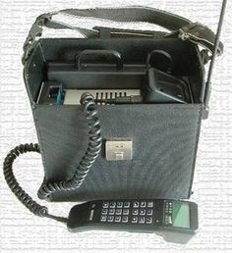
ASALI DA SAMUWAR WAYAR SALULA A DUNIYA (ci gaba)
Asali da samuwa
Kasashe 6: Amurka, da Ingila, da Jamus, da Rasha (USSR), da Suwidin, da Finland
Daga me? == Rediyon sadarwa masu hanyar sadarwa daya (2-way radio) – RADIO RIGS
BAG PHONES = Na mota, jone da wutar mota, ba tashar sadarwa. Ana iya sa su cikin jaka. Kasar Amurka, 1911
1926 – Yaduwa zuwa kasar Jamus. RADIO TELEPHONY. Cikin manyan jiragen kasa daga Berlin zuwa Hamburg, da na sama.

Slide 19
ASALI DA SAMUWAR WAYAR SALULA A DUNIYA (ci gaba)
1940: Kamfanin MOTOROLA ya canza musu tsari. Manyan wayoyi iya girman dantse. WALKIE TALKIE, hukumar Sojin kasar Amurka.
1946: Injiniyoyin kasar Rasha – DG Shapiro da Zaharchenko, bincike kan tsarin sadarwa mai cin zangon kilomita 20. Tsarin farko don hada alaka tsakanin wayoyi da tashar sadarwa.
1947: Douglas Ring da Rae Young, BELL LABS. Tsarin sadarwa na tsibi-tsibi (daga tasha zuwa tasha). Ba a zartar dashi ba a aikace.
1956: SonyEricsson, Suwidin. MOBILE TELEPHONE SYSTEM A (MTA) mai nauyin 40kg.
1965: Suka daidaita zuwa nauyin 9kg. Kwastoma 600 zuwa 1983.
1957: Rasha = Injiniya Leonid Kupriyonovich, sunansa LK-1, daga baya RADIOPHONE. Mai dauke da “Antenna”, amdani da tashar sadarwa – base station – a tazarar 20 – 30km. Tana da batir, iya kira na tsawon sa’o’i 20-30. 3kg

Slide 20
ASALI DA SAMUWAR WAYAR SALULA A DUNIYA (ci gaba)
1958: Leonid ya kayatar da ita zuwa nauyin 500gm.
Duk ana kira da amsa kira ne a wuri guda, duk da cewa akwai tsarin jonuwa da tashar sadarwa. Kana fita daga garinku ko unguwanku yanayin sadarwa zai dauke
1970: Injiniya Amos Joel Jnr, BELL LABS, Amurka.
Tsarin sadarwa daga zango zuwa zango (Call Hands-off). Daga gari zuwa wani gari, daga unguwa zuwa wata unguwa
1971: AT&T ta samar da tsarin ADVANCE MOBILE PHONE SERVICE (AMPS).
1971: Hukumar FINLAND, ta samar da tsarin ART
Wannan aka ci gaba da ingantawa har zuwa wannan zamanin namu.

Slide 21
MARHALOLIN TSARIN SADARWAR WAYAR SALULA
Mobile Phone Generations
Marhala ta Hudu “4G/LTE”
Marhala ta Uku “3G”
Marhala ta Biyu “2G”
Marhala ta Farko “1G”
Marhalar Asali da Samuwa “0G”
“5G”
“6G”
“7G”
“8G”

Slide 22
MARHALOLIN TSARIN SADARWAR WAYAR SALULA
Marhalar Asali da Samuwa (Zero Generation – “0G”)
Marhalar ginshiki da shimfida: 1911 – 1982; murya kadai, ba sakonnin tes.
Marhalar Farko (1st Generation ko “1G”)
Daga 1983 – 1990: tsarin analog, amfani da tsarin hasken lantarki don aikawa da murya ko kira.
Amfani da tashar rediyo, RADIO TOWER
Ba tes sai murya kadai. Akwai saibi wajen aika kira, ga kwaramniya a cikin sautin sadarwa
Marhala Ta Biyu (2nd Generation ko “2G”)
1991 - 1999: daga tsarin “Analogue” zuwa “Digital” – tsarin sarrafa murya ko sautin mai kira zuwa lambobin sifiri da daya.
Tsarin sadarwa na: GMS (Finland da saura), da CDMA (Amurka), daga tsohon tsarin AMPS na AT&T.

Slide 23
MARHALOLIN TSARIN SADARWAR WAYAR SALULA (ci gaba)
Marhala ta Uku (3rd Generation ko “3G”)
2000- 2012: hukumar ITU, fitar da sababbin hanyoyi sadarwa mai suna: INTERNATIONAL MOBILE TELECOMMUNICATIONS-2000 (IMT-2000)
Inganta kira, aikawa da sakonnin tes da MMS, da GPRS, da VIDEO Call, tsarin GSM mai inganci (gsm-edge) da CDMA.
Marhala ta Hudu (4th Generation ko “4G/LTE”)
2013 – Yau
Inganta kira da sakonni, da tsarin Intanet mai inganci, mai daukan bayanai masu yawa cikin kankanin lokaci
Masu zuwa:
Marhala ta Biyar “5G”
Marhala ta Shida “6G”
Marhala ta Bakwai “7G”
Marhala ta Takwas “8G”

Slide 24
ASALI DA SAMUWAR WAYAR SALULA A DUNIYA (ci gaba)
Adadin Layukan Tarho a Najeriya (Maris, 2016)
Lamba | Tsarin Sadarwa | Adadi
1 | Tsarin GSM | 211,732,836
2 | Tsarin CDMA | 3,678,796
3 | Tsarin Fixed Wireless | 353,830
Jimilla |  | 215,765,462

Slide 25
ASALI DA SAMUWAR WAYAR SALULA A DUNIYA (ci gaba)
Adadin Layukan Tarho Masu Rai (Active Lines)
Lamba | Tsarin Sadarwa | Adadi
1 | Tsarin GSM | 147,398,854
2 | Tsarin CDMA | 1,170,031
3 | Tsarin Fixed Wireless | 176,579
Jimilla |  | 148,745,464

Slide 26
ASALI DA SAMUWAR WAYAR SALULA A DUNIYA (ci gaba)
Adadin Layukan Tarho na Kamfanonin Waya
Lamba | Kamfani | Adadi
1 | MTN Nigeria Communications | 61, 262,140
2 | Globacom Limited | 33,011,094
3 | Airtel Nigeria | 32,268,301
4 | EMTS Limited (Etisalat) | 22,161,290
5 | Visafone Limited | 2,197,657
6 | Multilinks Telkom | 10,815
7 | 2st Century Technologies | 103,124
8 | IPNX | 2,823
Jimilla |  | 151,017,244

Slide 27
DALILAN YADUWAR HANYOYI DA KAYAYYAKIN SADARWA A NAJERIYA
Saukin mu’amala
Saukin farashi
Yaduwar nau’uka daban-daban
Tsarin zumunci a tsakanin na’urorin sadarwa (Network Convergence)
Karuwar ingancin hanyoyin sadarwa
Kebantattun siffofin fasahar Intanet
Ingancin ka’idojin kimiyyar sadarwa
Dokoki da tsare-tsaren Hukuma

Slide 28
FA’IDAR HANYOYI DA NA’URORIN SADARWA
Karuwar ilimi da wayewa kan harkokin duniya
Gamammen tsarin sadarwa
Fahimta da karantar da addini a sawwake
Aikin yi ga jama’a
Saukin rayuwa wajen mu’amala da:
Hukuma
Makarantu
Kamfanoni
Bankuna
Karatu da karantarwa a fannonin rayuwa
Saye da sayarwa
Karuwar kudaden shiga

Slide 29
HADARIN MU’AMALA A KAFAFEN SADA ZUMUNTA
Cin mutuncin addini
Rage wa addini mutunci da kima
Izgili ga addini da ahalinsa
Hasarar addini da imani
Gurbatattun akidu
Gurbatattun fatawowi
Gulma da hirar banza
Karya da yaudara
Hotunan karya
Shafukan bogi
‘Yan 419: daga SMS, zuwa Imel, zuwa Social Media. Shafukan shahararrun mutane. Masu rokon katin waya
Safaran miyagun kwayoyi
Instagram

Slide 30
HADARIN MU’AMALA A KAFAFEN SADA ZUMUNTA (ci gaba)
Kashe-kashe da ta'addanci
Boko-haram, ISIS etc da shafuka har da hashtag highjack
Cynthia ogugofor, jos, lagos. 2011
Zina da Dillacinsa
Mace da namiji
Mace da mace
Namiji da namiji
Batsa da ashararanci
Hotuna
Bidiyo
Murya (whatsapp voice note)
Dodorido/lalube cikin duhu
- Rashin hakikanin al'amura
- BBC Reporter Interview

Slide 31
HADARIN MU’AMALA A KAFAFEN SADA ZUMUNTA (ci gaba)
Rashin manufa takamaimai
Me kaje yi, da wa kake abota? dsr
Rashin sirri wajen mu'amala
Bayananka a hannun wasu
Hotunanka a hannun wasu
Sakon ‘Group’ na kowa ne a Whatsapp
Hotunan jonathan da namadi
Wahalar tantance masu miyagun laifuka
Sai da hadin kan masu shafin
Amfani da GPS bai da hakika
Amfani da ISPs ba tabbas
Bayanan da suke bayarwa na karya ne
Shagala da shagaltarwa
Kamuwa da cutar shakuwa da Intanet (Internet Addiction)

Slide 32
HADARIN MU’AMALA A KAFAFEN SADA ZUMUNTA (ci gaba)
Rokon Katin Waya (Mata-Maza)
Wauta da kauyanci (Facebook Follies, CBC, 2012)
Dan sanda mai wankin mota (amurka)
Barawo mai satar account (amurka)
Gayyatar bikin ranar haihuwa (jamus)
Ray Lam, dan takarar siyasa a Canada

Slide 33
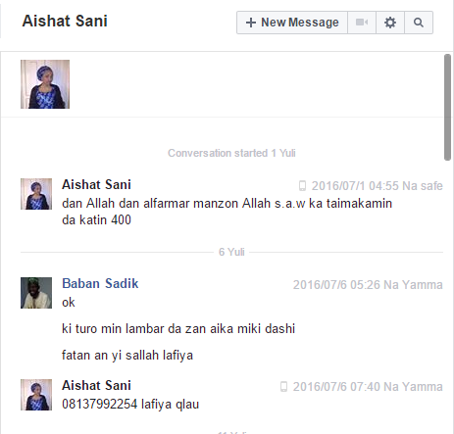
HADARIN MU’AMALA A KAFAFEN SADA ZUMUNTA (ci gaba)

Slide 34
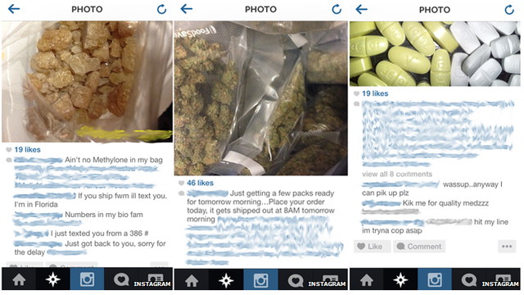
HADARIN MU’AMALA A KAFAFEN SADA ZUMUNTA (ci gaba)

Slide 35
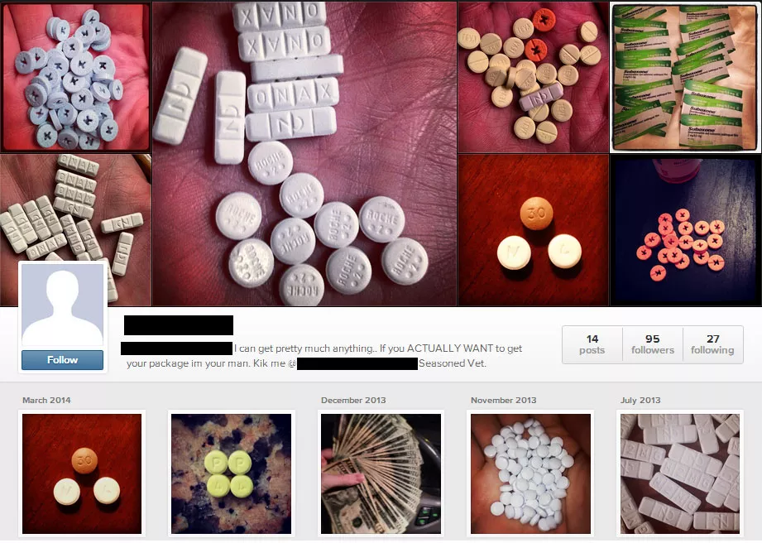
HADARIN MU’AMALA A KAFAFEN SADA ZUMUNTA (ci gaba)

Slide 36
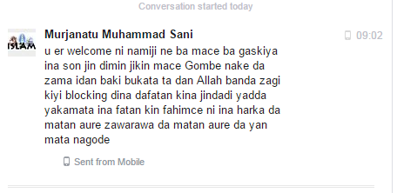
HADARIN MU’AMALA A KAFAFEN SADA ZUMUNTA (ci gaba)

Slide 37
KAMMALAWA
Hanyoyin sadarwa na dada yawaita sanadiyyar kirkire-kirkire a fannin kimiyya da fasahar sadarwa
Iya sanayyarka ga halin da ake ciki iya wayewarka
Guguwa ce mai dauke da iska mai karfi, wacce ke tumbuke duk wanda ya fuskanceta babu manufa kyakkyawa, kuma tabbatacce a tare dashi
Kashi 60 cikin 100 na masu mu’amala a wannan saaha ba su da manufa tabbatacciya, mai kwari. Don haka, kada ka dogara gare su.
Mahalli ne mai cakude da fari da baki, da mai zaki da mai daci, da mai lami da mai gardi; dole ne ka zabi dandanon da ya dace da kai, kada ka bi zabin wasu, domin dandanonku ya sha bamban
RIGA-KAFI, YA FI MAGANI

Slide 38
TAMBAYOYI
?

